Slide 1
CSS - floats
Viktoras Lava www.viktoraslava.lt

Slide 2
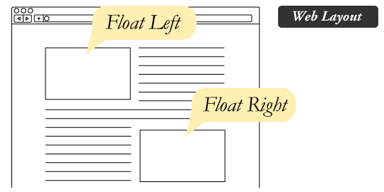
Floats
Float is a positioning property.
The main purpose of the float is to wrap text around images or elements.
For many years floats were used to build layouts. However, right now it’s better to use flex to build layouts.

Slide 3
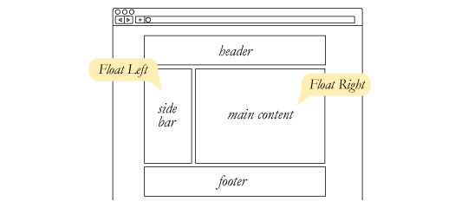
Floats for building layouts
Try to avoid floats for layouts if it is possible, use display: flex better.

Slide 4

Float left
.left { float: left; }
Can be used to force the block elements to go in one line, starting from the right.
However, then you will need to use a clearfix to clear elements below.
Example

Slide 5

Float right and left
.right { float: right ; }
Can be used to force the block elements to go in one line, starting from the right.
However, then you will need to use a clearfix to clear elements below.
Example

Slide 6
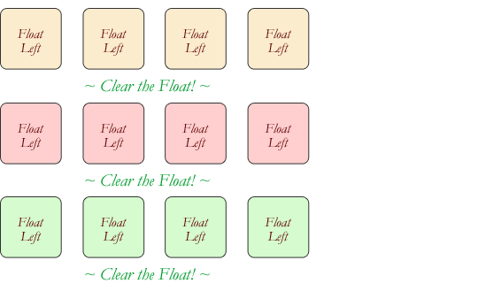
What is clearflix?
Clearfix is a CSS rule that fixes zero-height element issue for floated elements. It looks like this:
.clearfix:after { content: ""; display: table; clear: both; }
Example

Slide 7
Questions?

